Slide 1

Customer Segmentation Presentation
By: Data Planet

Slide 2
Agenda
Project Recap
Problem
Meet the Team
Process
Insights
Summary

Slide 3
Project Recap
Company Overview:
Prominent automobile manufacturer in Australia.
Experiencing significant decline in sales among young professionals impacting overall revenue.
Project Goal:
Conduct customer segmentation analysis to identify key customer groups within the young professional segment.
Predict future purchasing behaviors and devise personalized customer experiences to improve customer engagement and retention rates.

Slide 4
Problem
Research indicates lack of personalized customer experiences.
Young professional segment specifically affected.
Comprehensive customer segmentation analysis needed
Identification of key customer groups based on demographics, purchasing habits, and preferences.
Analysis of past purchasing behaviours to predict future trends.

Slide 5
Meet the team
Data Engineering
Choice
Ugwuede
Adeoti Olatunde
Divin Kayeye
Data Science
Gbadeyanka Taofeek
Isaac Lukasa
Data Analysis
Mina-Ogie Ezinne
Kuponiyi Boluwatife
Odigie Alvin

Slide 6
Process
Understanding the Data
Data Cleaning
Data Modelling/ Customer Segmentation
Data Analysis
Insights from Data

Slide 7
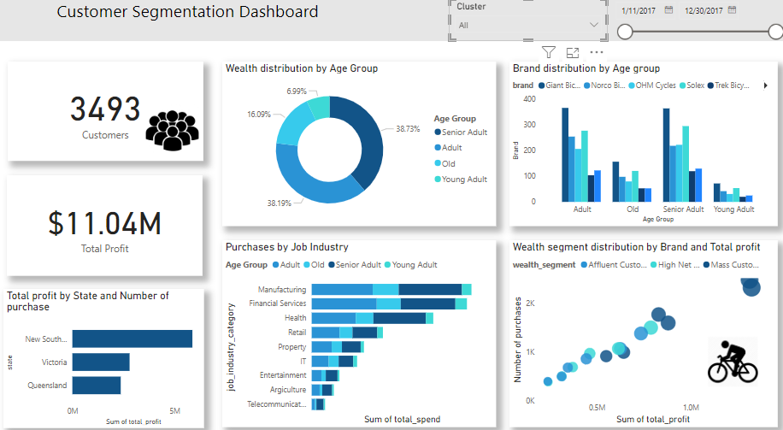
Insight

Slide 8
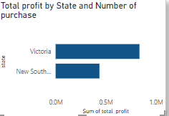
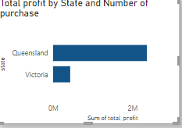
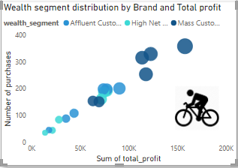
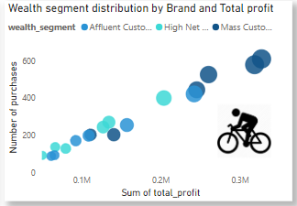
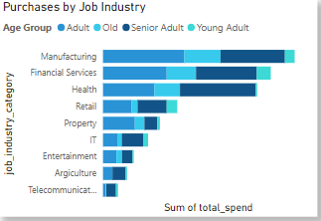
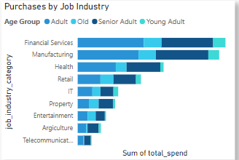
Insight
CLUSTER 0 CLUSTER 1

Slide 9
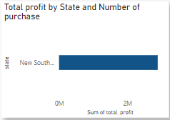
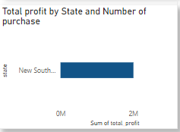
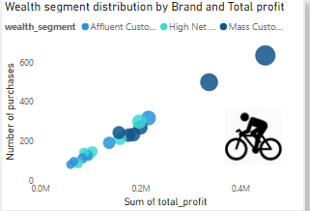
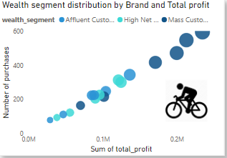
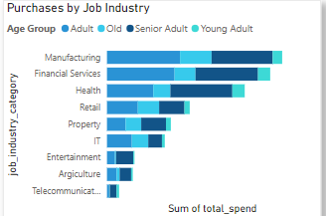
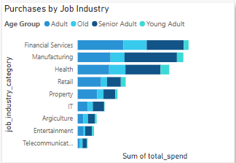
Insight
CLUSTER 2 CLUSTER 3

Slide 10
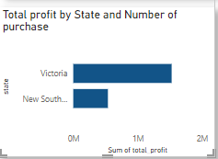
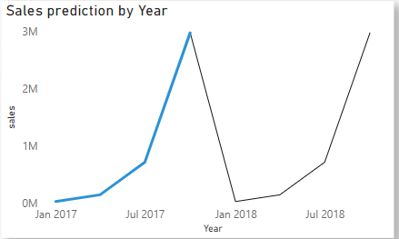
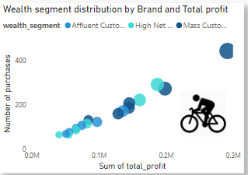
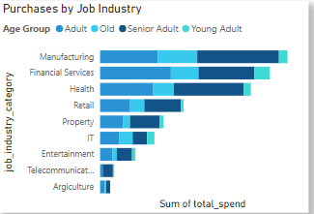
Insight
CLUSTER 4 PREDICTIVE ANALYIS CHART

Slide 11
Summary
We identified 5 customer groups based on their demography and purchasing behavior
Cluster 0 and 4 are residents of Victoria and New South Wales (NSW).
Cluster 0 and 3 customers purchase Solex, Giant, OHM and Norco Bicycles the most
Cluster 1 accumulated $2.80M profit
Senior Adults made the most purchases in Cluster 2. Total amount of profit amounted to
$2.89M
Cluster 3 customers reside in New South Wales while Cluster 4 customers are resident in
both New South Wales and Victoria.

Slide 12
Customer Spending Habits
Sales predictive analysis shows that sales will likely follow the same pattern, declining sales in the first quarter and sudden surge within the last quarter. Curating activities to promote bike usage within these down time can promote sales.
Brand Distribution by Age Group: Among the four unique brand names, Trek Bicycles appears to be the most popular brand among Young Adults, while Giant Bicycles is most popular among Senior Adults.
Purchases by Job Industry: Here, we learnt that Manufacturing and Financial Services has the highest number of purchases. These are the industry categories with the most purchases accruing almost half of the total profit.
Young Adult category has

Slide 13
Total Profit by Date: The month with the greatest profit is December. Between January to April, no profit was made.
Sales started to pick up in May, and it progressed from $68,281.15 in May to $4,686,456.47 in December.
Customer Geographic Distribution
Total Profit by State and Number of Purchases: New South Wales (NSW) is the state where the most profit was made which amounted to $5.87M of the $11.04M total profit.

Slide 14

Conclusion
From the insights we were able to get from the data; we can predict that Senior Adults and Adults will continue to make the most purchases because they earn the most and can afford to make these purchases.
We would suggest offering catchy offers like free insurance for some months to customers that fall under the Young Professionals Category.
Offering free customization services to the bikes they buy to give it a more personalized feel
Create engaging content for social media platforms. Partner with influencers to reach a wider audience
Sponsor local events and charities that young professionals care about.

Slide 15
Thank You
we are Open to TAKE questions NOW.
We will be happy to assist you on next steps to take.

